Slide 1
Digital Storytelling with Mapping:
KnightLab StoryMap
Developed by Colleen Nugent
Taught by Talia Brenner and Julianna Wessels
HIST 1130: Introduction to US History
Gretchen Heefner
Fall 2020
Feel free to ask questions at any point during the presentation!
Notes:
20 minutes, with 5 or 10 for questions

Slide 2
Workshop Agenda
Learn about StoryMap as a mode of conveying data and content
Best practices and questions to consider before creating your StoryMap
Steps for using Knight Lab’s StoryMap
Start building!
Slides, handouts, and data available at https://bit.ly/-diti-fall2020-heefner

Slide 3
Workshop Objectives
Articulate the choices you make when telling a story using a map
Follow a step-by-step guide for creating, saving, and publishing maps using KnightLab’s StoryMap
Upload data into StoryMap, including location information, images, and text
Navigate StoryMap’s map markers and location-finding system

Slide 4
What is a “story map”?
Telling a story using maps!
“You combine authoritative maps with narrative text, images, and multimedia content. They make it easy to harness the power of maps and geography to tell your story.”
- ESRI Story Maps Website

Slide 5
Example Projects Using Maps to Tell Stories
Angelenos Incarcerated, Eddie’s Story: uses a map to both linearly and spatially tell someone’s story based on an interview (made using Omeka’s Neatline)
KnightLab StoryMap examples:
“Boston Parks and Playgrounds: Community Scan”: uses a mix of textual, image, and geo-location data to tell a story about playgrounds in Boston’s neighborhoods.
Arya’s Journey in Game of Thrones: uses an image of Westeros to trace and tell the story of Arya’s journey

Slide 6
Slides, or map markers
Each slide is a different marker point on your map/image. Each slide contains:
Title and text. The text box reads basic HTML.
A background image/color.
A map marker, which can be placed using Google Maps locations or by placing the marker manually.
Media: images, videos, and sound files can be uploaded. Since only one media file can be uploaded per slide, you can use the text box’s HTML to integrate an image or another media type.

Slide 7
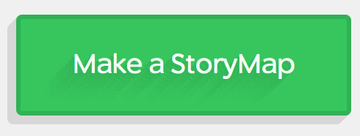
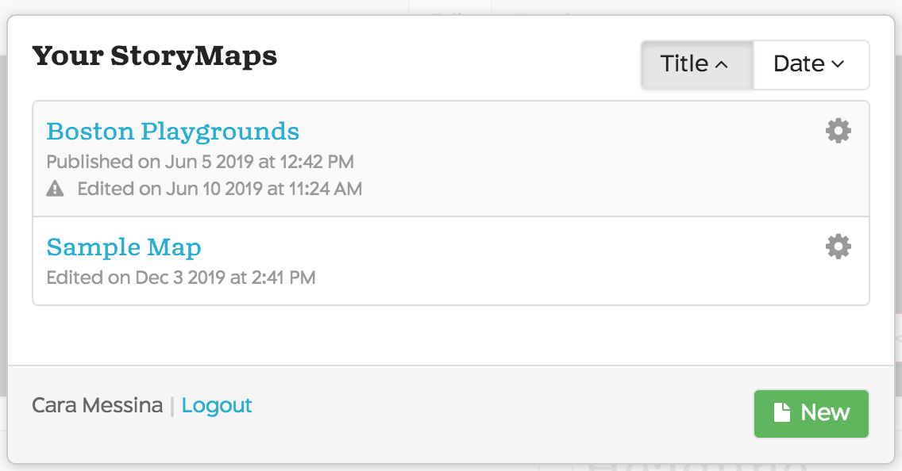
Create a StoryMap
Go to https://storymap.knightlab.com/
Click “Make a StoryMap”
Either create a new account or sign in through Google
Once you’re signed in, click “New Map” (once you have created your map, it will be there for you to work on)
Name your project

Slide 8
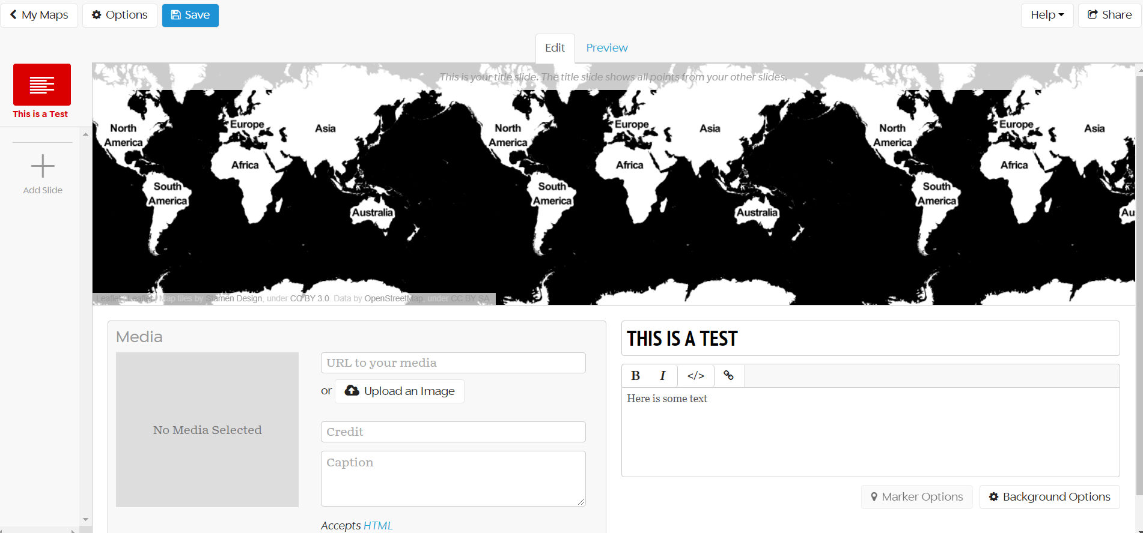
Your StoryMap
Overall options (like changing map layout)
SAVE OFTEN!
Preview your slides
Preview the geographic points in all of your slides
Title and content of your text box
Check out and add new slides here
Uploading photos or other media! Document what you upload
Color of the text box background

Slide 9
Slides, or map markers
Each slide is a different marker point on your map/image. Each slide contains:
Title and text. The text box reads basic HTML.
A background image/color.
A map marker, which can be placed using Google Maps locations or by placing the marker manually.
Media: images, videos, and sound files can be uploaded. Since only one media file can be uploaded per slide, you can use HTML to insert an additional image.

Slide 10
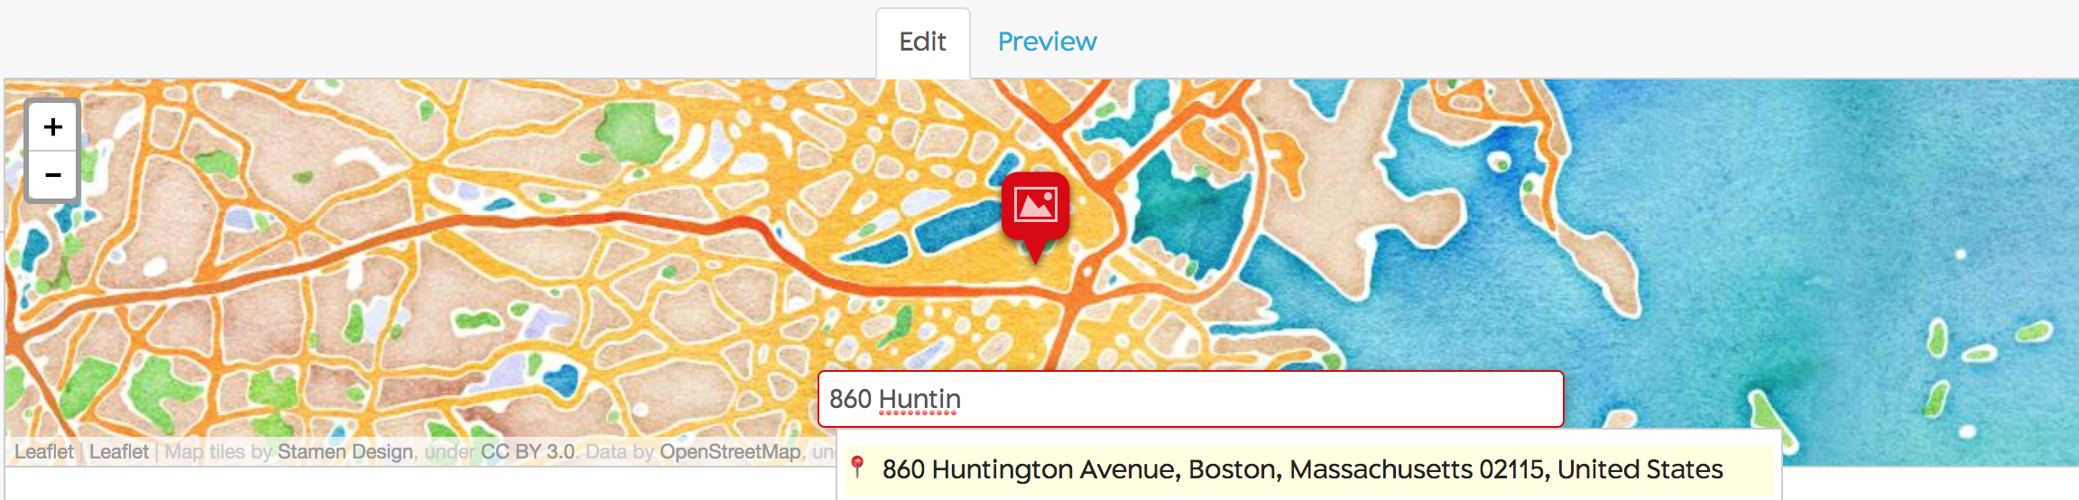
Add A Location
KnightLab StoryMap uses Google Maps to locate addresses
StoryMap, however, does not always recognize place names; you might need to know the address or location of particular structures
If you cannot find the address of a location, you can drag and drop the map markers to the specific location

Slide 11
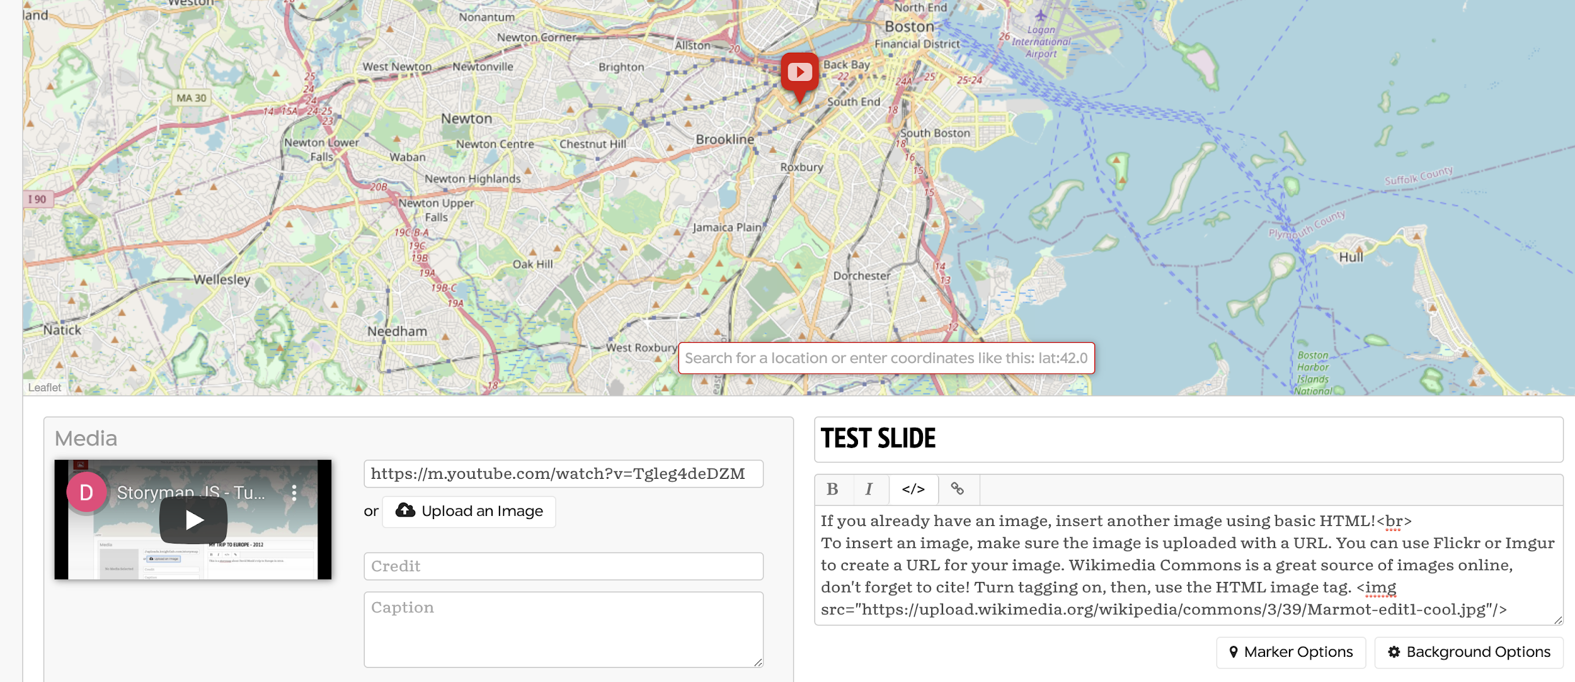
Add Media and Images to a Slide
If you have an image or a video in the “media” section, but want to include an image in the text, you can! The text box reads basic HTML.
Click the </> button (turn on HTML)
Get a URL of your image. Wikimedia Commons is a great source of images. Make sure to use the embed file code--don’t forget to cite!
Use the HTML <img src="URL"/> tag to insert the image.
Check the “Preview” to see the image
Use “media” to upload files. You can upload an image or put a URL of an image OR a video (like a YouTube video). If you want to include your own video, you will first have to upload it to YouTube and copy that link.

Slide 12
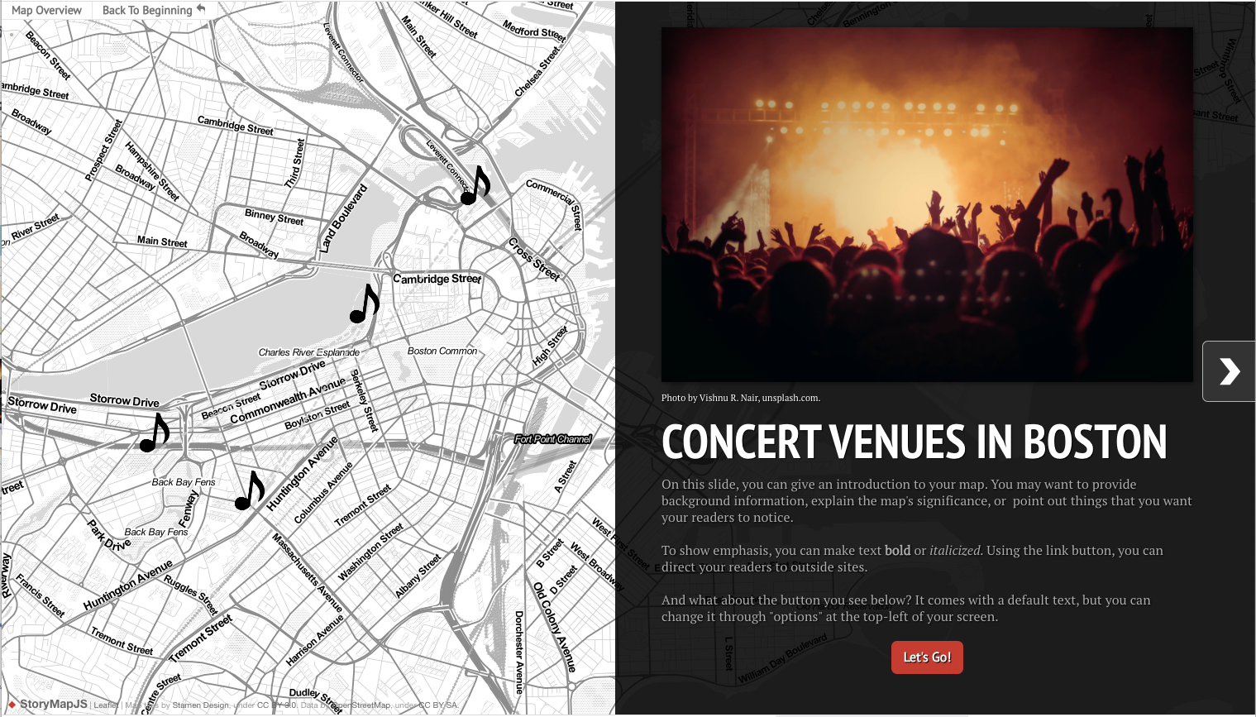
StoryMap Demo
—Demo Map Link

Slide 13
Activity: Start creating your virtual walking tour!
Create your own short StoryMap with 2-3 stops on your proposed walking tour. These points should come from the spreadsheet you have been building. The goal here is to show that you have used the StoryMap software and are thinking about what an effective narrative map looks like.
Suggestions:
Create around 2-3 map markers, not including the “start”
Include images with each slide
Include at least one video

Slide 14
Discussion
How do you think differently about these locations when they are in a StoryMap format?
What was difficult or easy about this platform?
What was interesting about seeing your data presented in a StoryMap format?

Slide 15
Thank you!
If you have any questions, contact DITI at nulab.info@gmail.com
Developed by Colleen Nugent
Digital Integration Teaching Initiative
DITI Research Fellow
Taught by Talia Brenner and Julianna Wessels
Digital Integration Teaching Initiative Digital Integration Teaching Initiative
DITI Research Assistant DITI Research Fellow
Slides, handouts, and data available at https://bit.ly/-diti-fall2020-heefner
Schedule an appointment with us! https://calendly.com/diti-nu

